Slide 1
Network analysis

Slide 2
Datasets and tools
Data: mrredges-no-tweet-no-retweet-poi-counted
Tools: Python, Networkx, Matplotlib
Graph | Nodes | Edges | Self-loop | Density | Is_connected
DiGraph of Reply | 4038 | 28992 | 0 | 0.00177849689775 | NA
DiGraph of Mention | 3513 | 17227 | 0 | 0.00139629440146 | NA
UnDiGraph of Reply | 4038 | 22062 | 0 | 0.00270676038619 | False
UnDiGraph of Mention | 3513 | 15429 | 0 | 0.00250112339005 | False

Slide 3
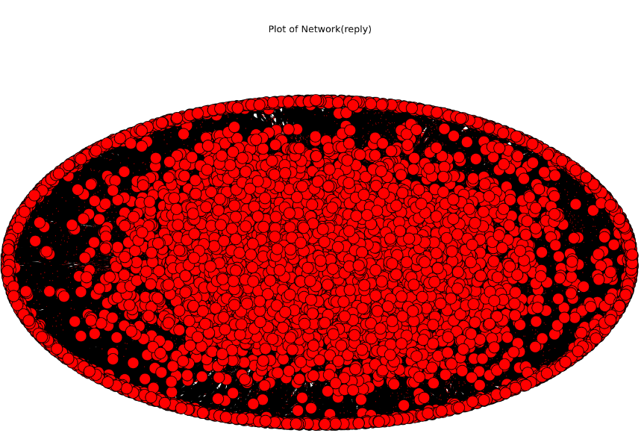
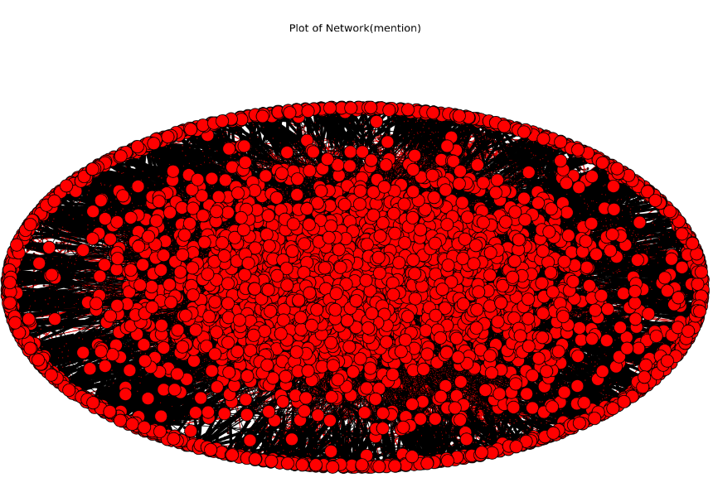
digraph Topology of network
The nodes in mention network seems more partitionable than those in reply network.

Slide 4
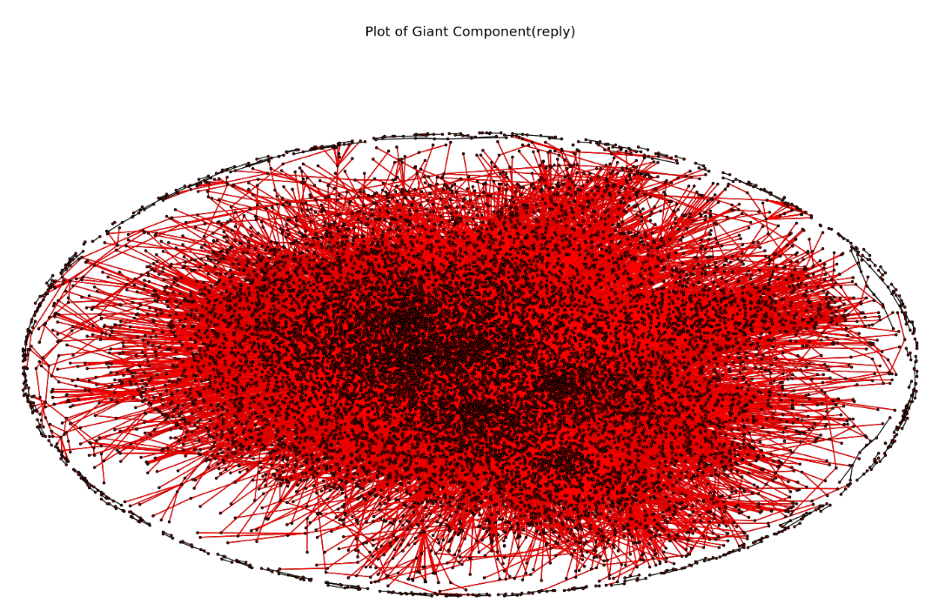
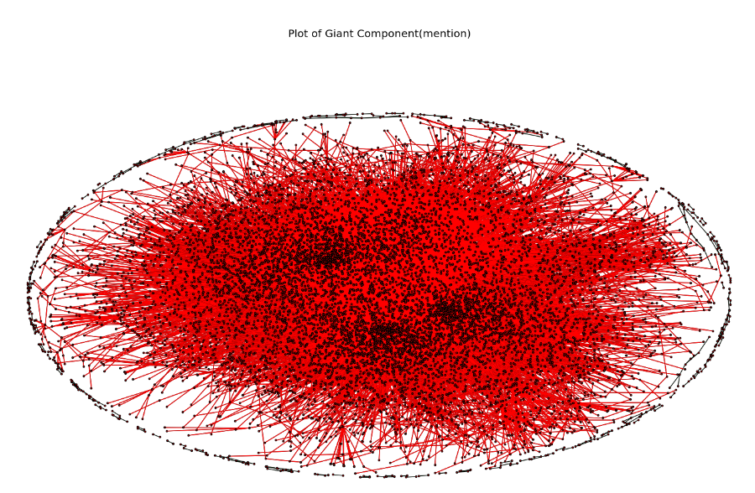
Components (Undigraph)
number of components in network: 66
the size of giant components: 3892/4038 ratio: 96.4%
number of components in network: 80
the size of giant components: 3332/3513 ratio: 94.8%

Slide 5
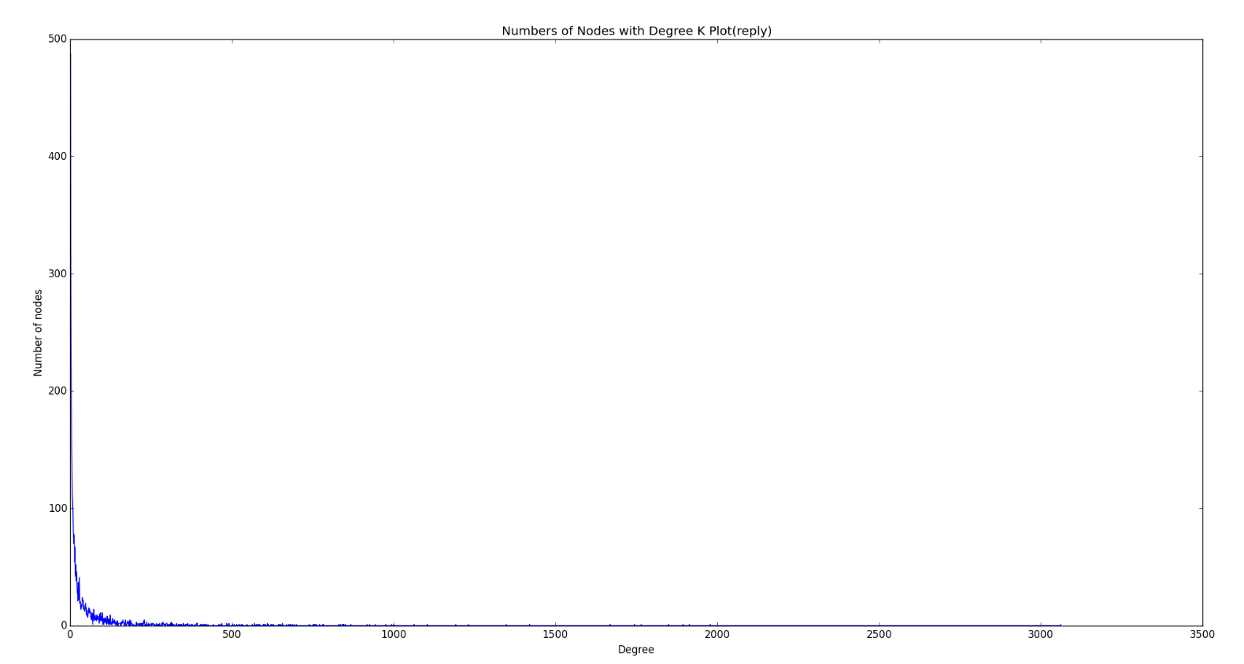
Degree distributions in DiGraphs

Slide 6
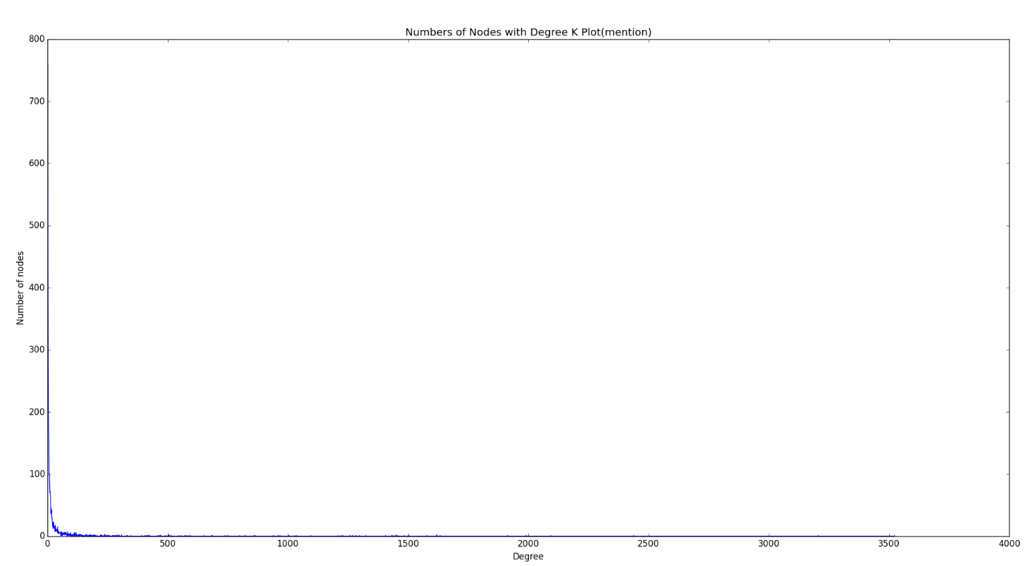
Degree distributions in DiGraphs

Slide 7
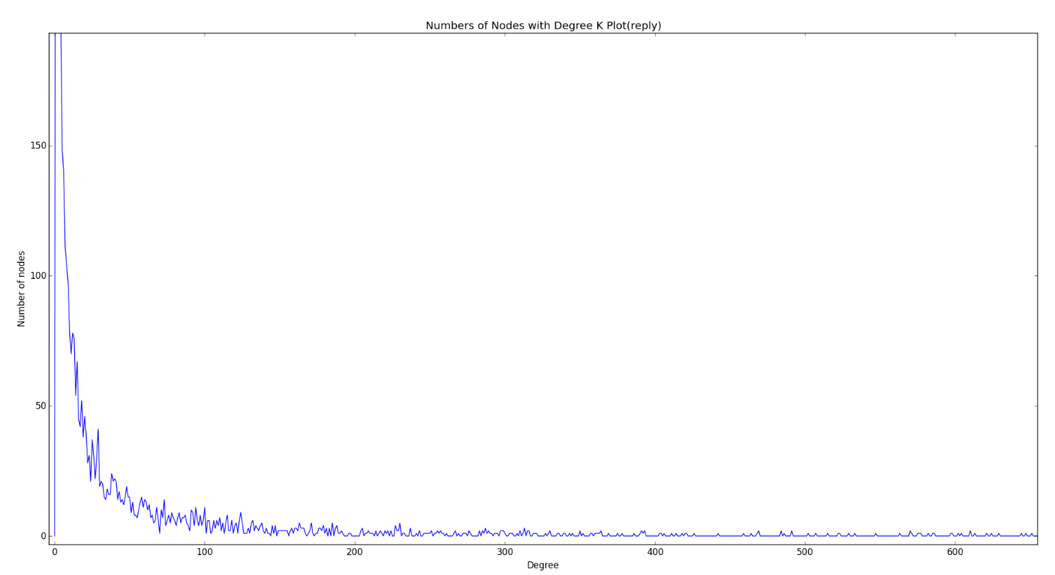
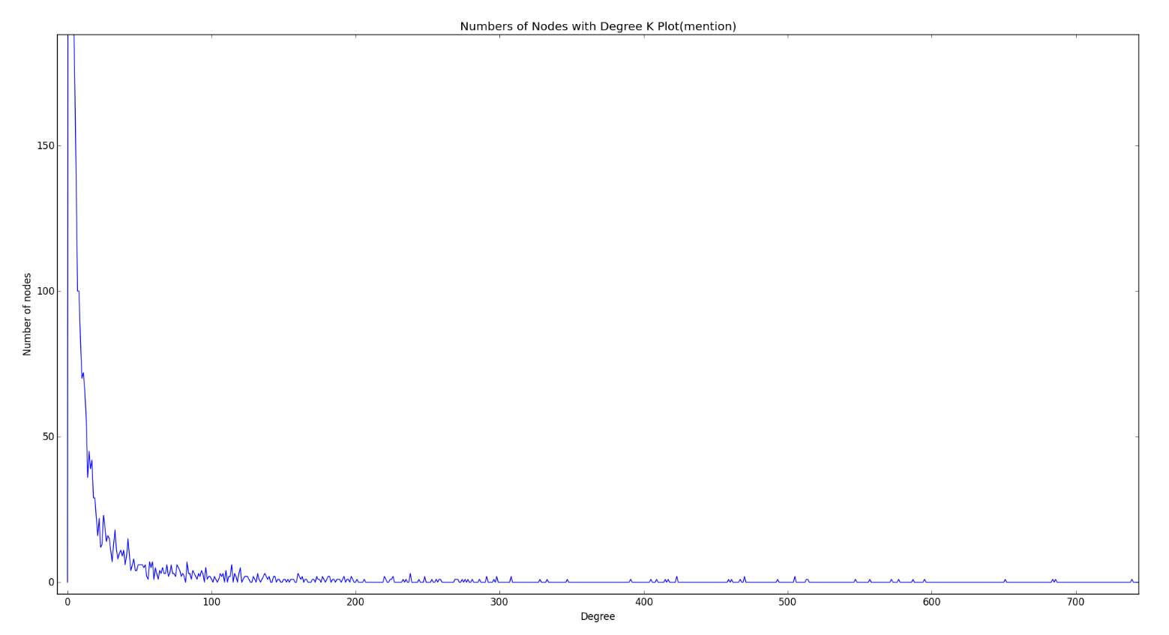
Degree distributions in DiGraphs
The numbers of nodes with the degree within [20, 75] in reply network are more than those in mention network.

Slide 8
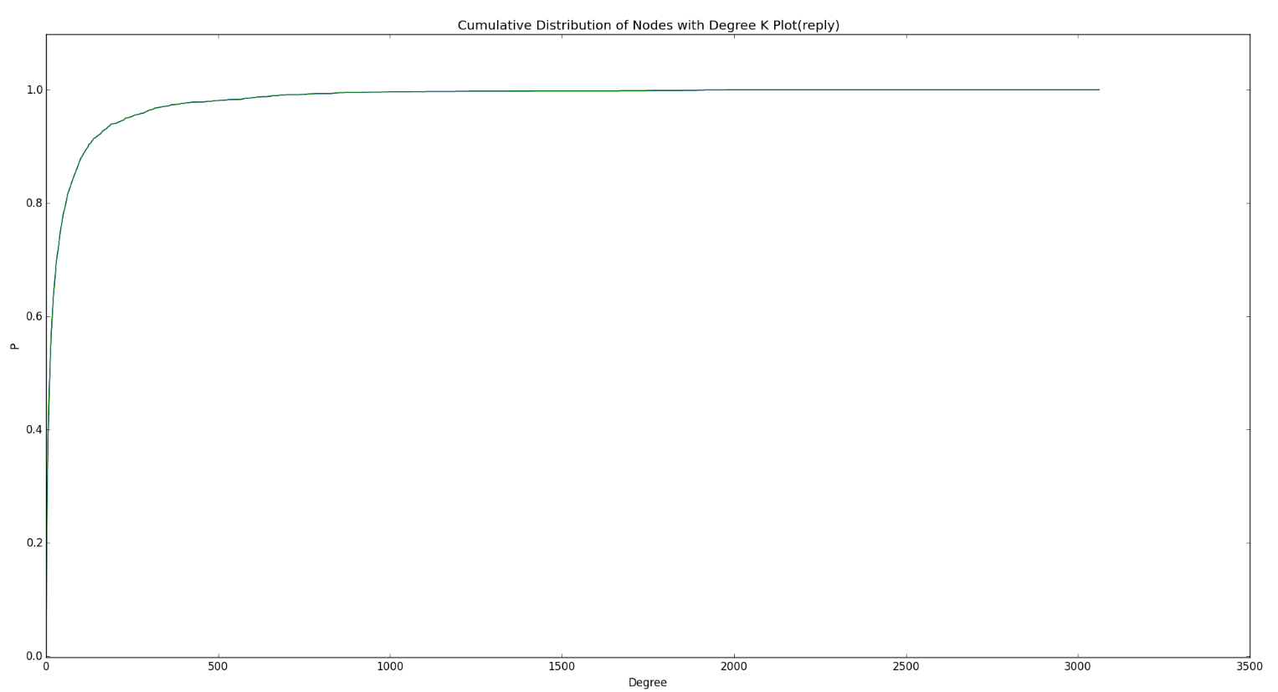
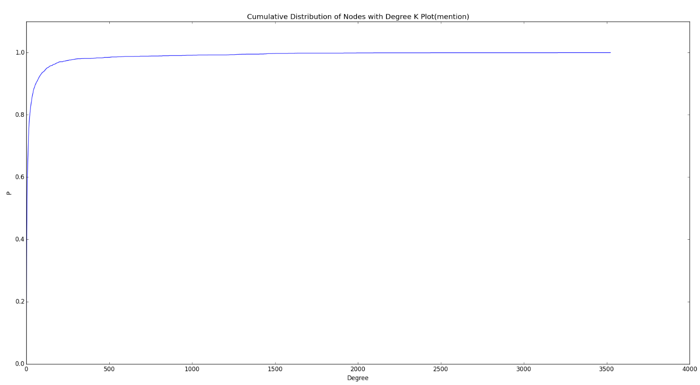
Degree distributions in DiGraphs
Hence, the cumulative probability of mention network reaches its peak in the smaller range of degrees than reply network.
→ How are their tail distributions?

Slide 9
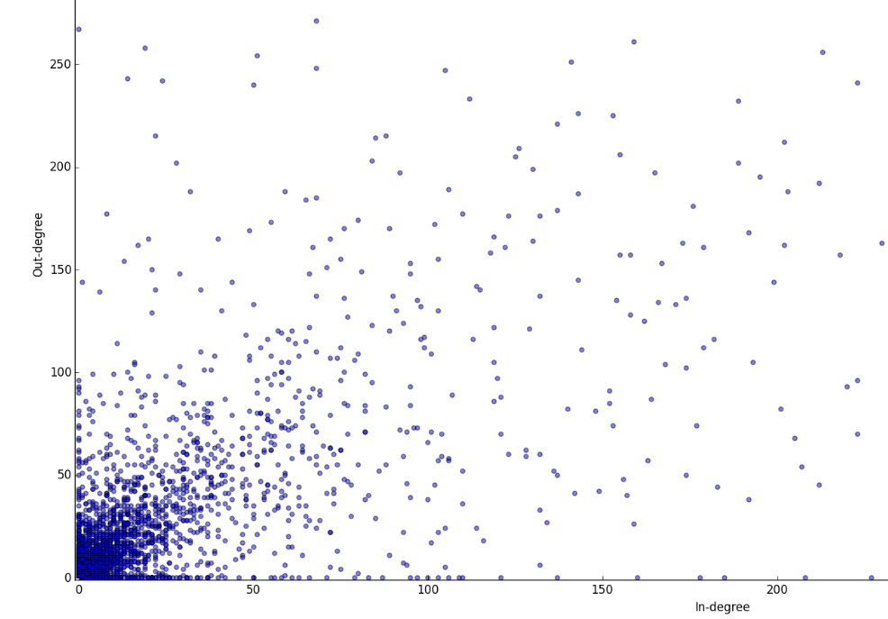
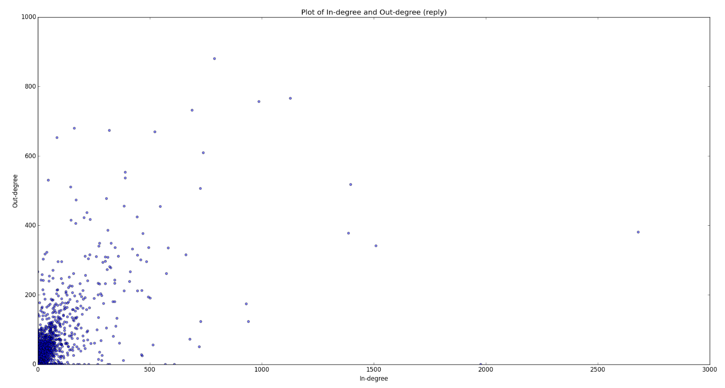
Relationship between reply indegree and outdegree
Avg(inD) = Avg(outD) = 26.8457157008
Pearson correlation: 0.622772

Slide 10
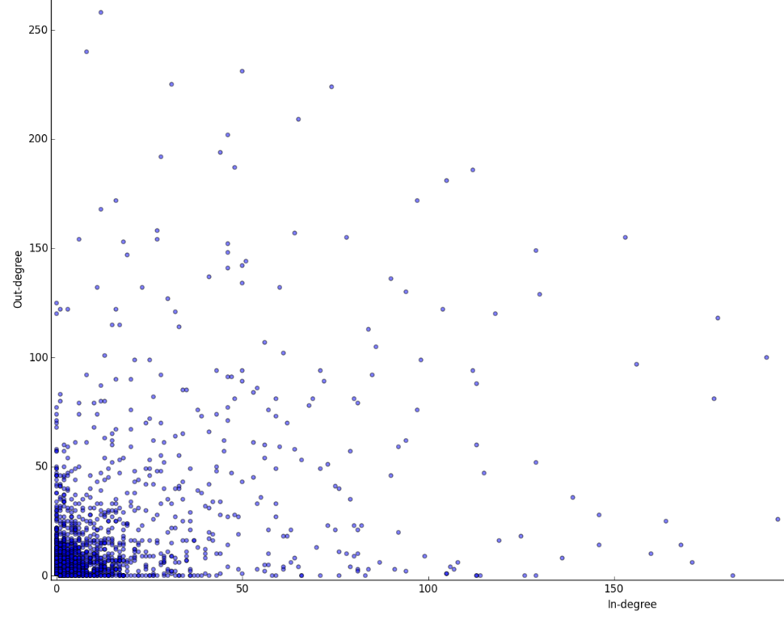
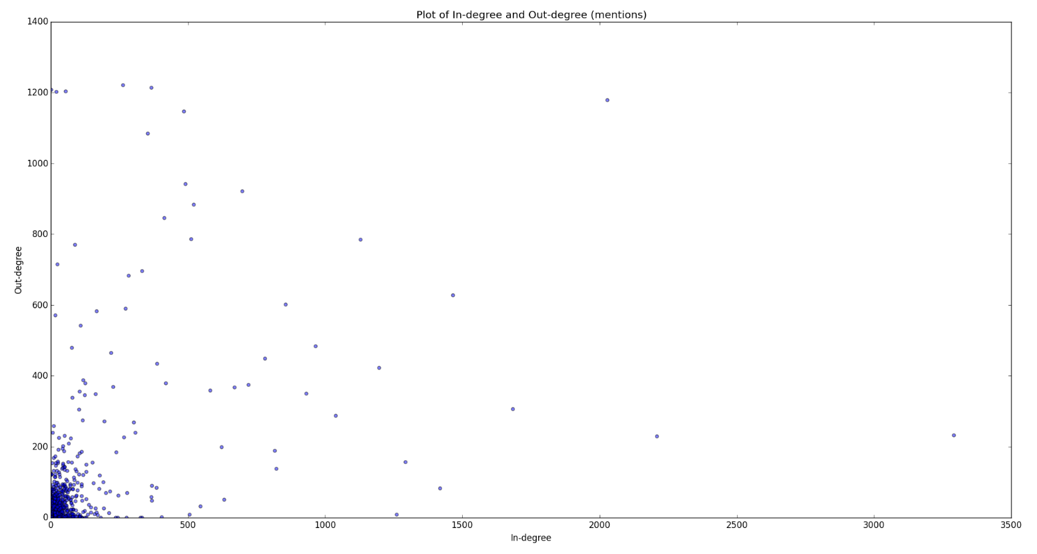
Relationship between mention indegree and outdegree
Avg(inD) = Avg(outD) = 19.0839738116
Pearson correlation: 0.476349

Slide 11
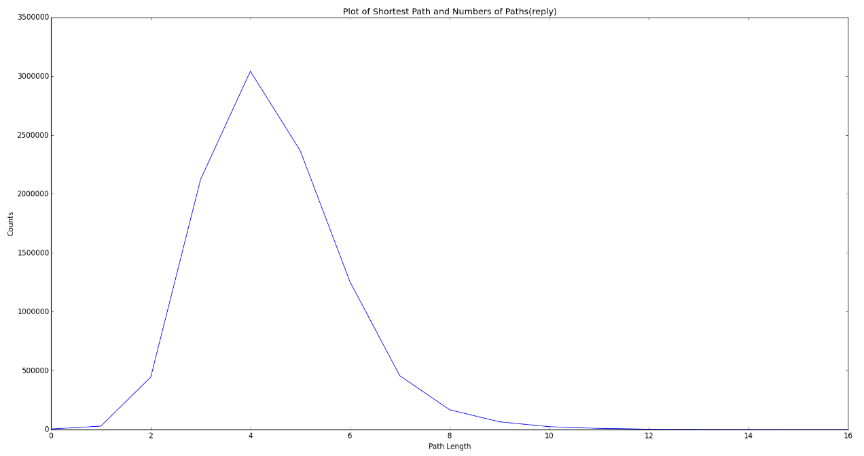
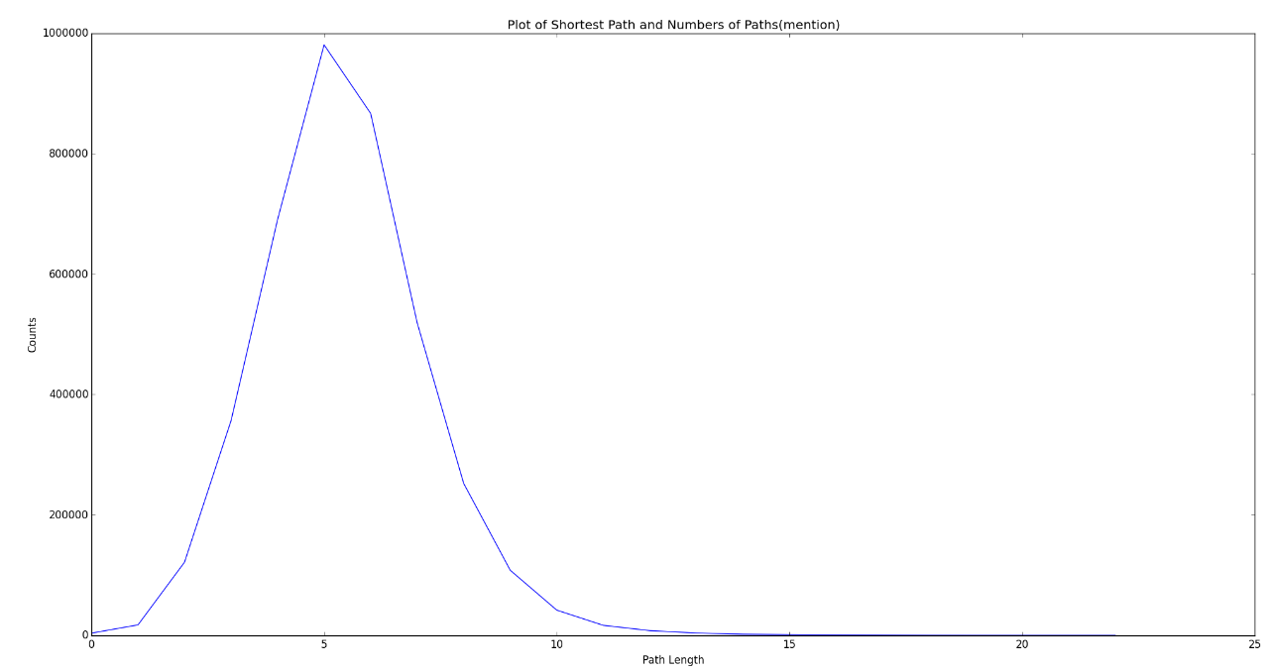
Directed Path distribution of users
The mean of path length is 4
The mean of path length is 5
The path of mention is generally longer than that of reply
→ the reachability of reply is typically higher than mention

